Slide 1
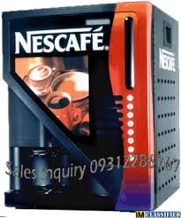
Nescafe Machine
The basic properties and functionalities of a Nescafe machine need to be implemented.

Slide 2

Coffee
Nescafe
Milk
Green Tea
Water

Slide 3
Coffee Functionalities
By clicking on coffee button brown colored water should be filled in cup
By clicking on Milk button Smoke White colored water should be filled in cup
By clicking on green tea green colored water should be filled in cup
By clicking on water light blue colored water should be filled in cup
While clicking on single button other buttons should be disable.
After choosing your flavor then it will only filled upto ¾ th of the cup.
When ever a cup is already filled and a new button is clicked then the old
Content of the cup should be cleared and the new content need to be filled
starting from the bottom.

